Slide 1
Java mail & authorisation unit

Slide 2
But first…

Slide 3
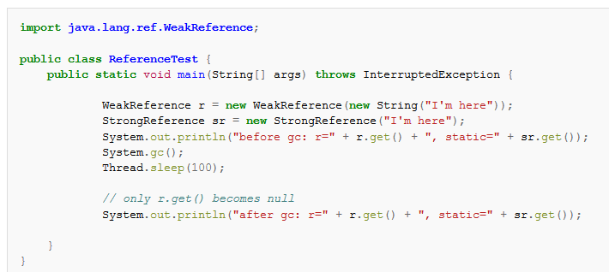
Weak reference

Slide 4
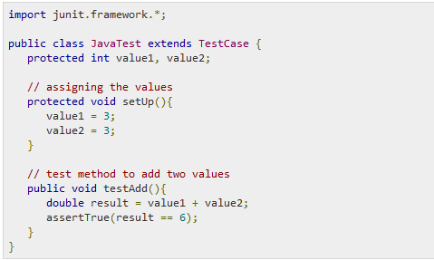
Junit Testing

Slide 5
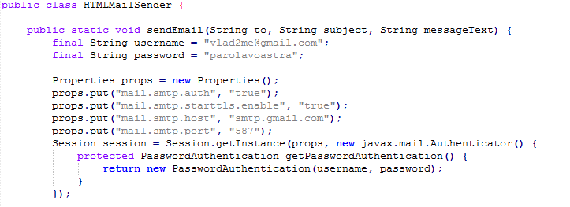
Javax mail

Slide 6
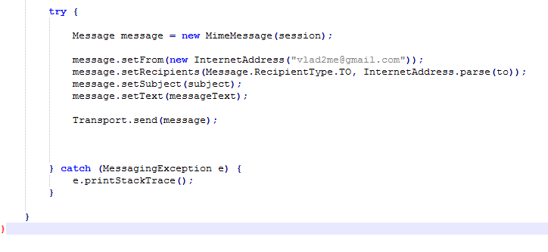
Javax mail

Slide 7
Application

